Slide 1


GROCERY
WEB APPLICATION USING MERN STACK

Slide 2
TEAM MEMBERS
CAROLINA CHRISTOPHER - 211521244008
SWETHA G S - 211521244053
UDHAYA E - 211521244056
ROSHINI R - 211521244044

Slide 3
TABLE OF CONTENTS
Introduction
Website architecture
Technologies used
Functional demo

Slide 4
INTRODUCTION
“grocery-store” is an online grocery store. It is a MERN Stack Project.Users can Log in to this website.Users Can view Products and Reviews in the Homepage. . When the user clicks the product, the product details can be viewed, then users add the products to cart. The cart data is saved in the MongoDB clusters .Users Can review their order history . Admins can access the website through the user login, can manage all products as well as manage all orders.

Slide 5
TECHNOLOGIES USED
Front End Technology:
React
React-Router
React-Redux
React-Bootstrap
Html
Css
Back End Technology:
Node
Express
MongoDb

Slide 6
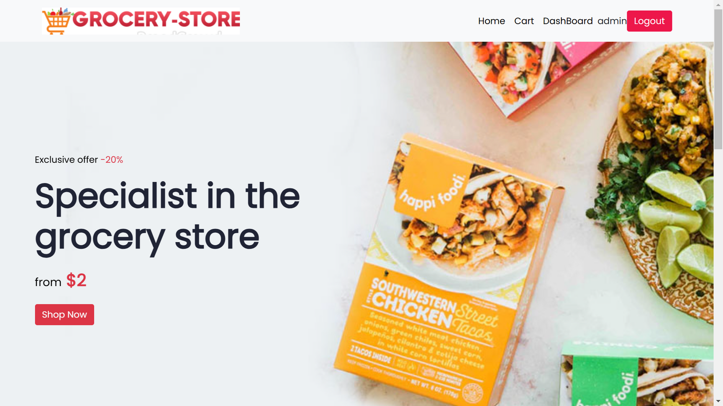
HOME PAGE

Slide 7
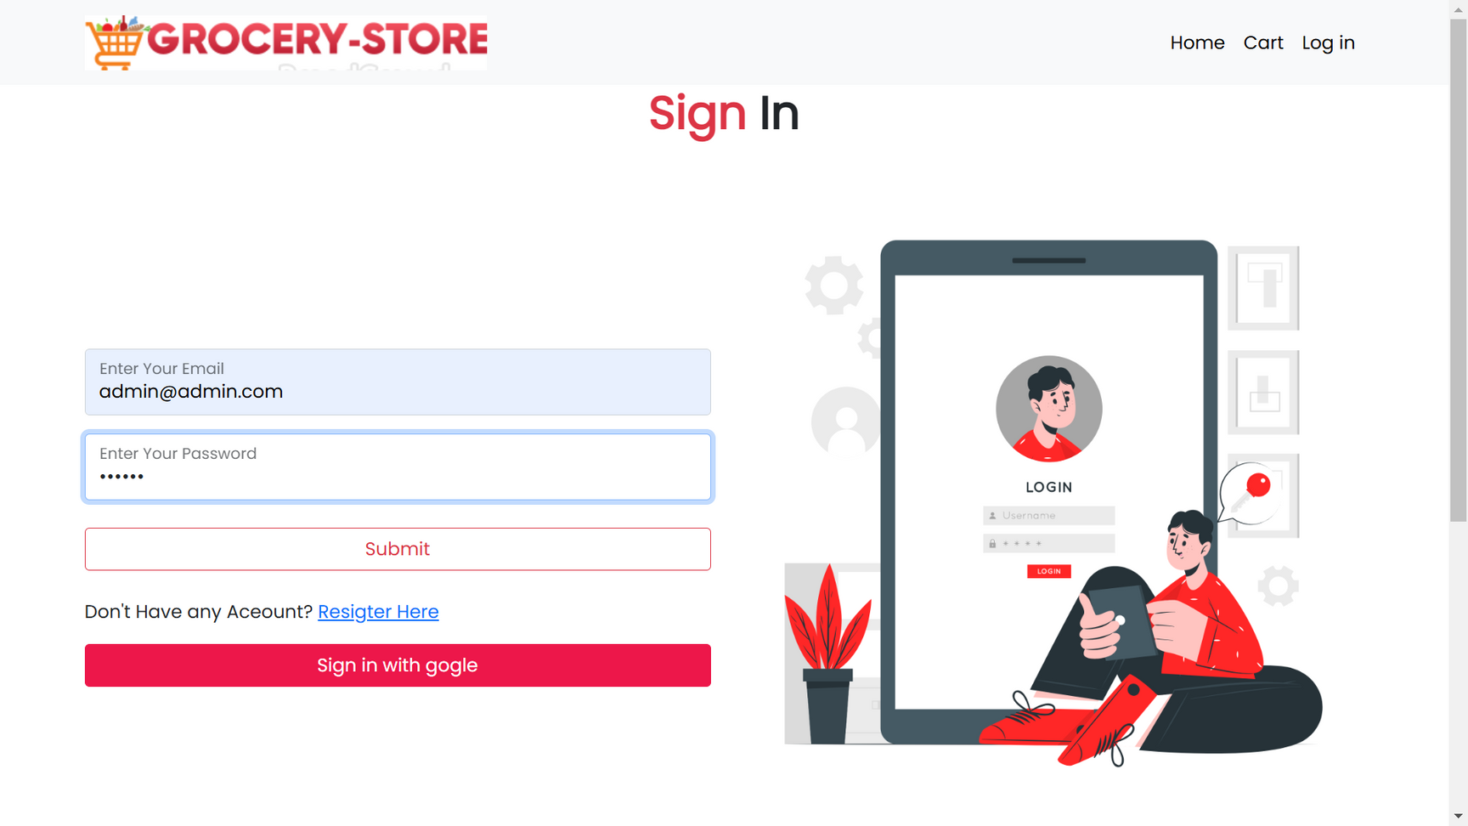
LOGIN PAGE

Slide 8
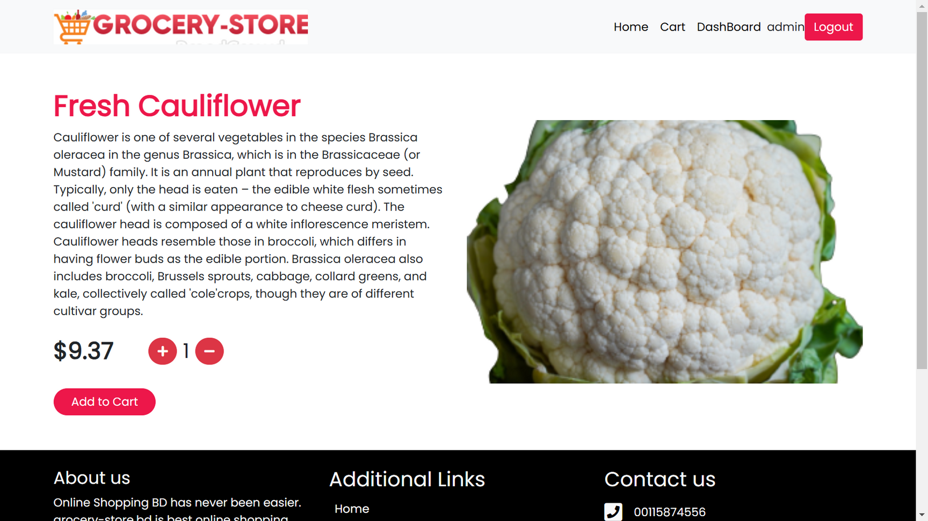
PRODUCT DESCRIPTION

Slide 9
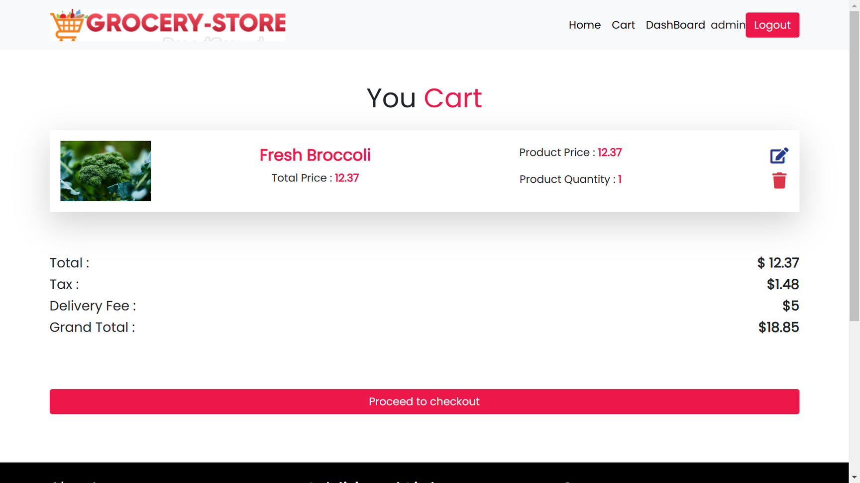
CART REVIEW

Slide 10
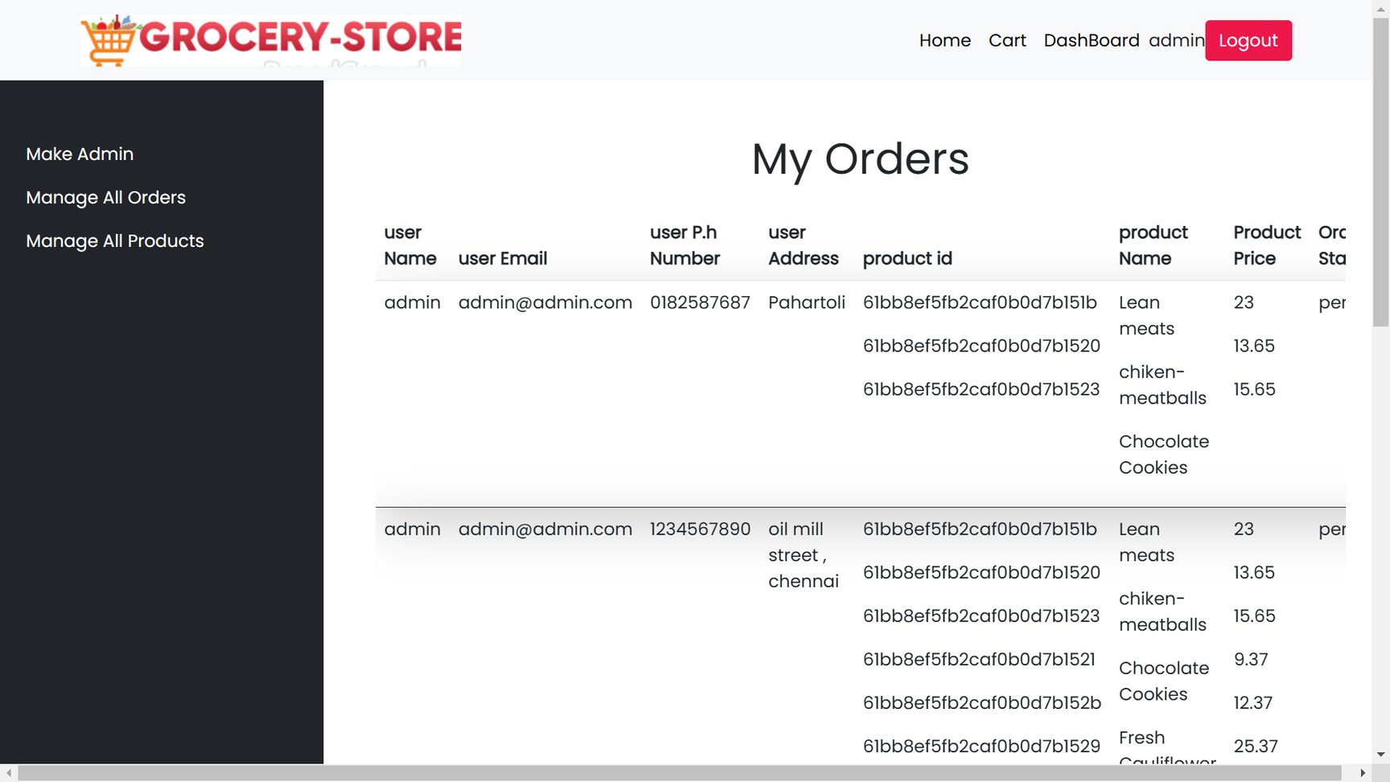
ORDER SUMMARY

